Slide 1
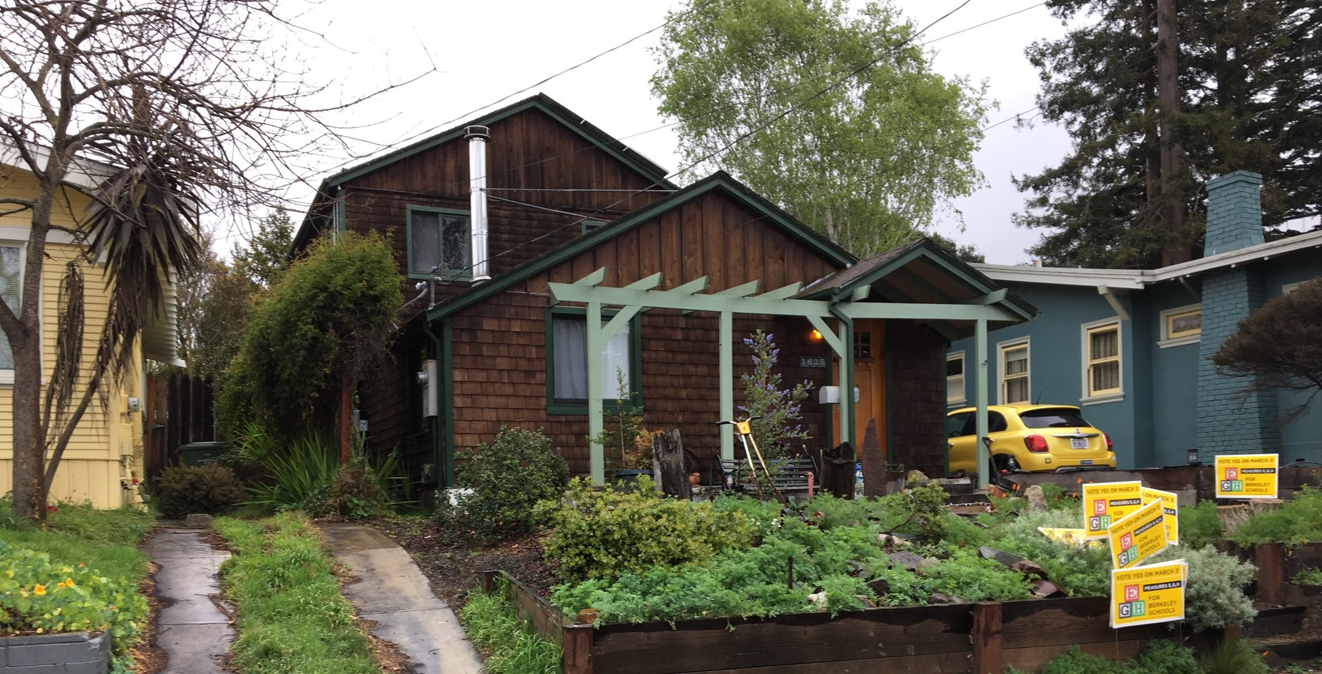
Berkeley’s Square Footage Database Disparities
Deepening the public’s understanding of the history, the problem and its implications on
the lack of equity in taxation
shortfalls in City revenues

Slide 2
Glad your interested in Berkeley Tax Inequities
We welcome you to learn more about how Berkeley collects taxes from its citizens.
Berkeley Voters have made clear through decades of generous tax approvals that they want residents to be taxed equitably. In the previous photo, one can clearly see the generosity of the taxpayer. That’s wonderful!
Prepare to be surprised by how the City has strayed from the desire of voters. The North Berkeley taxpayer in this photo, for example, is only charged for 1/4 of his square footage. Tax increases hurt them economically much less than homes which are mistakenly charged double for their dwelling size. His duplex in South Berkeley is also charged only half its square footage.

Slide 3
Berkeley’s Libraries Revenue Shortfalls of the 80s
After the passage of Proposition 13, Berkeley’s beloved libraries expected tough budgetary times.
In the early 80s, Berkeley voters approved a tax for the libraries on the square footage of their dwelling unit.
The city hired a group of college students to create a square footage database which would be used to tax homeowners and businesses.
The college students used 1950s-60s diagrams of all the buildings in Berkeley to create the database.

Slide 4
Through the years, voters approved 9 more assessments to support their city
Parks and Landscaping
Fire Dept Mello Roos
Fire/Disaster Preparedness
Paramedic Supplement
Disabled Services
Berkeley Schools
Berkeley Teacher Raise
Berkeley Schools Maintenance
Street Lighting

Slide 5
The Public Exposed Errors
1980s
Starting from the first years of the new library tax in the mid-80s, homeowners and business owners have complained of mistakes in their tax bill.
2002
Complaints from concerned citizens in 2002 uncovered underassessments and led the city to do a tax assessments audit. A small sample size (23 parcels)was corrected and back-billed.
2019
In 2019, concerned taxpayers uncovered overcharges and vast numbers of undercharges.

Slide 6
11 Harmed Homeowners Ask for Corrections
In July 2020, A group of mostly elderly and/or minority families collectively wrote a letter to the City’s Finance Department, who incorrectly imposes taxes on their non-dwelling spaces. The financial harm to these families is substantial. Their complaint is:
Dirt understory is not dwelling space, or even basement, because basements are defined by having floor material.
One of the Harmed families with a dirt understory has paid tax assessments on the dirt space ($900 a year) for decades. The city won’t allow it to be developed without raising the house. Their backdoor neighbor had an understory and then raised the house to make dwelling space, never paying tax then and still not paying now!

Slide 7
This Home is Charged Double
This Berkeley homeowner is elderly and sight-impaired. He is forced to pay for an unfinished understory, some covered only in dirt base. To move around in there, he has to hunch over to avoid hitting his head. Did we tell you that he is sight-impaired and elderly?
We don’t believe this is what voters wanted. The city shouldn’t tax undeveloped understories that are clearly not dwelling space.
This is not fair to this elderly homeowner and he should not be exploited to the tune of an extra $1200 every single year.

Slide 8
Understory has No Allowed Uses
Understory with insufficient ceiling height to walk upright is not a basement because building code for basements requires 6’4” height clearance. (UBC R305.1.1)
Zoning code does not allow ANY USE which is not permitted by the zoning code, so these dirt/low height clearance spaces are NOT USABLE. (BMC 23A.12.10)

Slide 9
Other Taxpayers Ensured Yearly Windfall
One Harmed Homeowner with unfairly taxed dirt space, has another neighbor who made their basement livable. They weren’t taxed before and are still not now. That duplex owner is not the only one with an unfair advantage. There are hundreds and hundreds of these.
Concerned citizens have quantified 700+ such undercharged properties at a loss the city revenues of over $4 Million over the last 10 years. There are a lot more losses to uncover! The work is time-consuming and mind-dumbing.
The city should be doing this data control work, not those who are harmed by the scheme.

Slide 10
Many Basements are NOT TAXED The following is a list of houses with untaxed basements like the one in photo
2100 block 6th
2300 block 9th
1000 block Addison
0 block Bay Tree
1900 block Berryman
800 block Camelia
1700 block Channing
0 block Codornices
600 block Colusa
1400 block Cornell
3100 block Deakin
1500 block Edith
1900 block Fairview
1200 block Francisco
1500 block Grant
2800 block Grant
1500 block Henry
2900 block Hillegass
1400 block Josephine
1600 block Julia
1200 block Kains
1400 block Kains
2000 block Lincoln
400 block Michigan
2800 block Milvia
1300 block McGee
1900 block McGee
1100 block Oxford
2900 block Pine
2500 Rose
1100 block Spruce
1600 block Stannage
700 block the Alameda
1600 block Tyler
700 block Vincente
500 block Woodmont

Slide 11
Or Developed and Livable and NOT taxed
North Berkeley
Rented on Airbnb
Full Height
Finished floors
Plumbing
Heating
Separate Entrance
House sold 2019

Slide 12
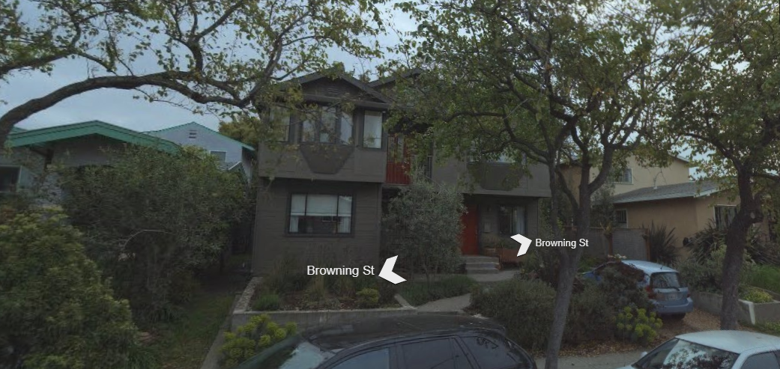
The Big Losses in Revenue are from Uncaptured Building Addition Square Footage
Property owners who add on to their homes or rental properties should have their building square footage record updated. But, all too often, this is not done, so available city revenues are lost.
This multi-family rental is 3367 ft2, but the City only imposes tax on 720 ft2.
This saves the landlord $2700 a year, shortchanging city services!

Slide 13
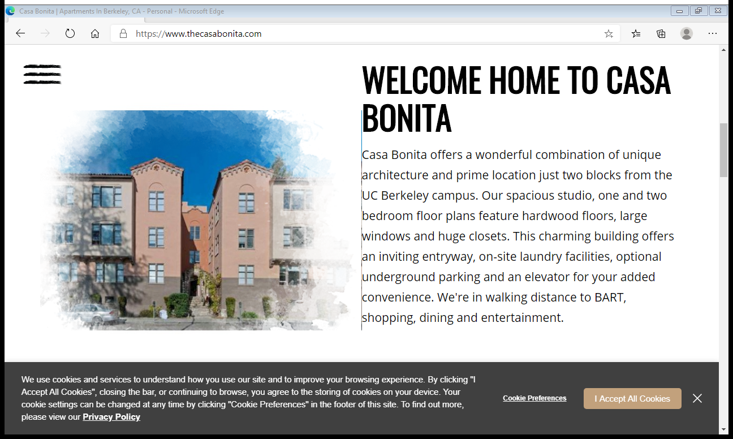
Larger Multi-Unit buildings Save More
This 24-unit building, the City’s building department says has 26,700 ft2, but the Finance Department calculates their tax assessments on 2,670. This factor of 10 results in a yearly $24,000 windfall to this property owner.
Meanwhile, the rest of us are asked to accept tax hikes in 2020 because the fire department and schools say they don’t have enough money.
How do the tenants of these artificially fortunate landlords feel about their rental payments not paying sufficiently for city services? We think, they would be mad about it, if they knew.
Not surprisingly, there is not much transparency about how much property owners pay for city services. Landlord saves $24K, city suffers!

Slide 14
When a New Home is Built, the old Square Footage is often NOT updated
This home in the hills was rebuilt in 1995. The new square footage could only be found hand-written on page 90 of the plans. Nonetheless, the County Assessor knows this house is 5846 ft2. Why does the city think and therefore charge the house still 1264 ft2?
Homeowner saves over $4600 a year, and city services suffer

Slide 15
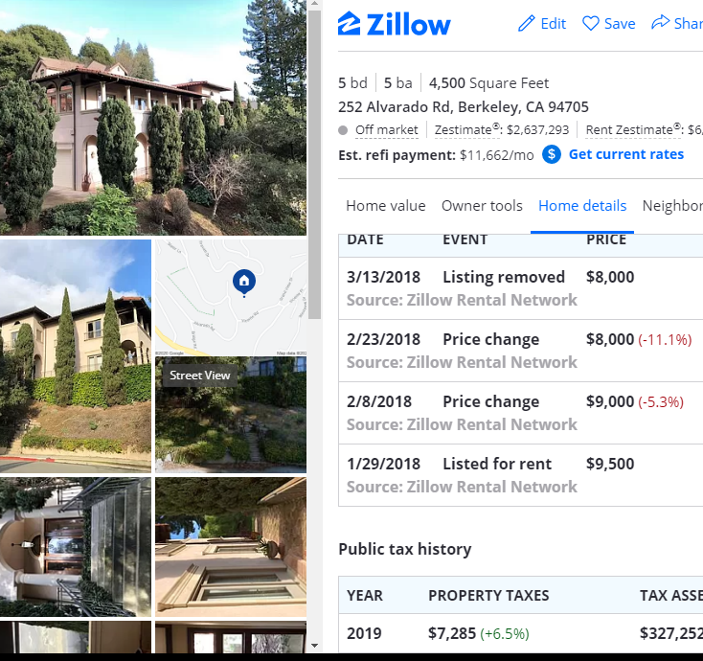
Or this Rental Home
This beautiful Mediterranean last offered for rent at $8,000/mo.
With that kind of income, this landlord could certainly afford to pay their fair share of city services. But, instead the city chooses to charge this landlord only for 2312 ft2, even though the home is 5844 ft2. The county assessor and Berkeley building department know how big this home is…
Landlord saves $3500/year and city services suffer!

Slide 16
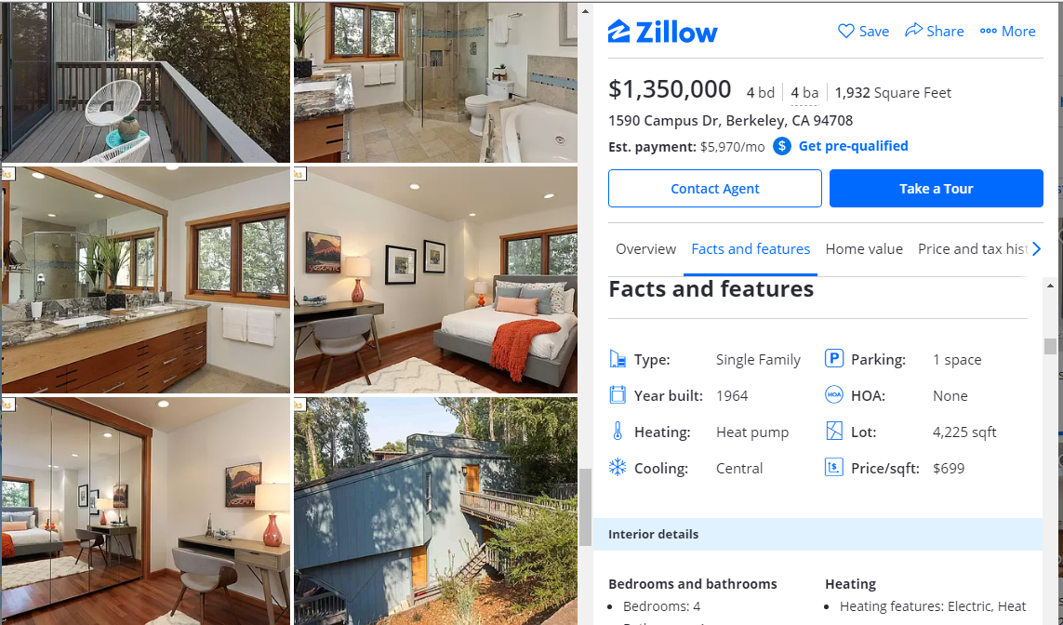
Building Inspection is Good Opportunity for Correction – but opportunity is squandered
This home currently on the market is charged $500 a year less than it should be for city services, even though it has had building inspections in 1996, 2003, 2004, 2006, 2011, 2016 which included converting crawlspace to storage and other changes like termite, roofing, fireplace, decks, etc. Want to schedule a showing with the realtor and see the untaxed square footage for yourself?
Assessor’s public ft2: 1932, City charges 1419 ft2. Homeowner saves $513 a year.

Slide 17
Berkeleyans who Benefit from this Scheme are Subsidized by those unfairly Overcharged
Several members of the City Council, a female candidate running for judge, some heads of city departments, CEOs of local non-profits are some of the artificially fortunate homeowners.
The city allows them to add on to their homes, unencumbered with tax, building wealth while the 11 Harmed Homeowners are finding it hard just to survive financially right now.
The City needs to Reform – past auditors have urged a Reconciliation of Records between County Assessor/City Building Department and the City’s Finance Department for decades.
Its time for citizens to demand the same.

