Slide 1
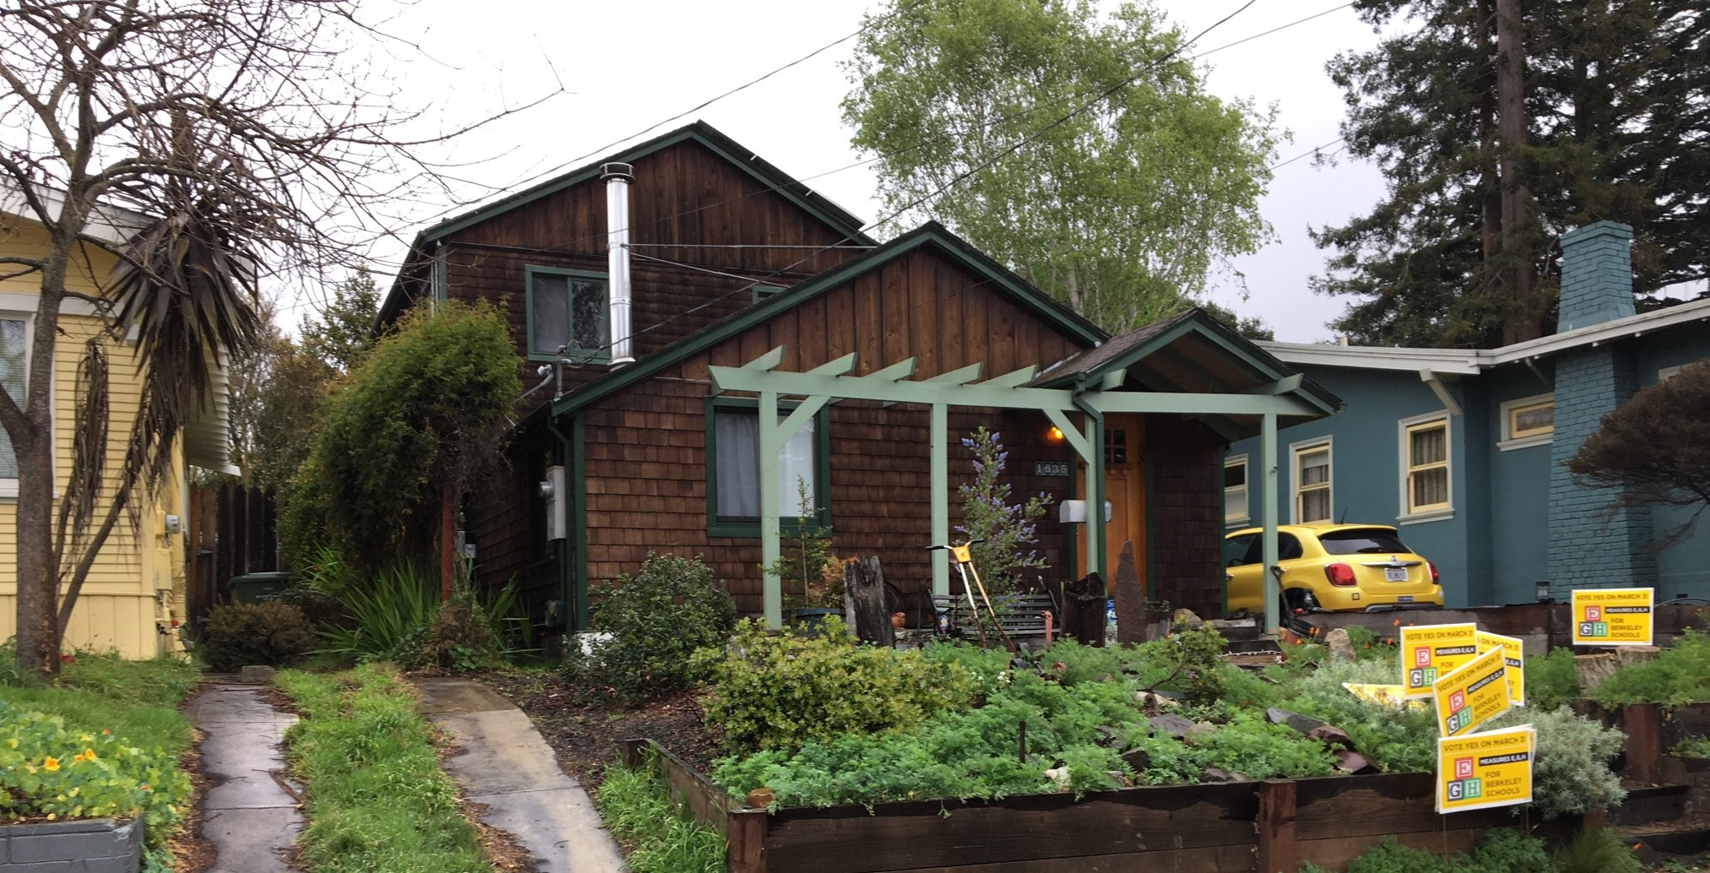
Berkeley’s Square Footage Database Disparities
Deepening the public’s understanding of the history, the problem and its implications on
the lack of equity in taxation
shortfalls in City revenues

Slide 2
Through the years, voters approved 10 assessments to support their city
Libraries
Parks and Landscaping
Fire Dept Mello Roos
Fire/Disaster Preparedness
Paramedic Supplement
Disabled Services
Berkeley Schools
Berkeley Teacher Raise
Berkeley Schools Maintenance
Street Lighting

Slide 3
2008 Fire Tax Measure GG
CITY ATTORNEY'S IMPARTIAL ANALYSIS OF MEASURE GG ORDINANCE AUTHORIZING AND ADOPTING A SPECIAL TAX TO FUND FIRE PROTECTION AND EMERGENCY RESPONSE AND PREPAREDNESS The City’s Fire Department, including its capital and operating costs, is supported almost entirely from the City’s general fund. This ordinance would authorize a special tax of 4.083¢ per square foot of improvements in dwelling units and 6.179¢ per square foot on all other improvements.

Slide 4
Dwelling Unit defined in BMC tax code
7.56.020 Definitions.
…..
C. "Dwelling" shall mean a building or portion of a building designed for human occupancy.
D. "Dwelling unit" shall mean a building or portion of a building designed for or occupied exclusively by one family.

Slide 5
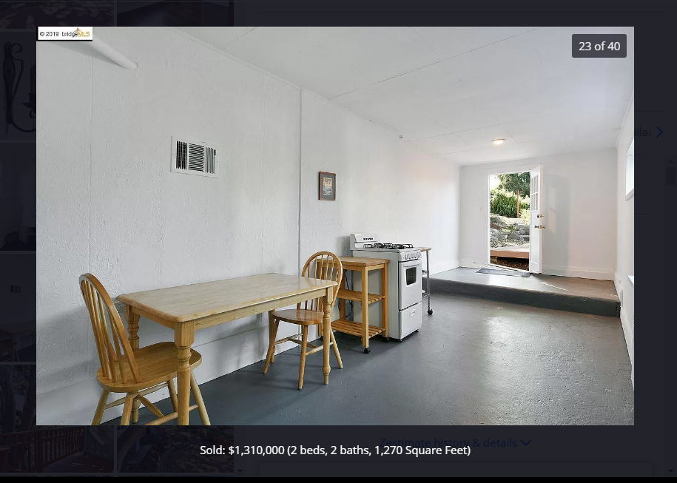
Taxation of Understories The basement on the left is UNTAXED. The understory on the right is TAXED
Not Taxed
Taxed

Slide 6
In 1992, this home’s foundation was rebuilt with a crawlspace of 6ft. In height. They are still not taxed on crawlspace, or UNUSABLE space, to this day.

Slide 7
Most undeveloped understories are in fact NOT TAXED The following is a list of houses with untaxed understories, like the one in photo
2100 block 6th
2300 block 9th
1000 block Addison
0 block Bay Tree
1900 block Berryman
800 block Camelia
1700 block Channing
0 block Codornices
600 block Colusa
1400 block Cornell
3100 block Deakin
1500 block Edith
1900 block Fairview
1200 block Francisco
1500 block Grant
2800 block Grant
1500 block Henry
2900 block Hillegass
1400 block Josephine
1600 block Julia
1200 block Kains
1400 block Kains
2000 block Lincoln
400 block Michigan
2800 block Milvia
1300 block McGee
1900 block McGee
1100 block Oxford
2900 block Pine
2500 Rose
1100 block Spruce
1600 block Stannage
700 block the Alameda
1600 block Tyler
700 block Vincente
500 block Woodmont
Not taxed

Slide 8
Attics – even when usable, are often untaxed
From the Landmark Preservation Ordinance application for 2043 Lincoln – this attic remains untaxed, though claiming USABLE LIVING SPACE

Slide 9
Though many understories and attics are untaxed
Untaxed
Untaxed
This would be expected according to Code, which does not allow ANY USE which is not permitted by the zoning code(BMC 23A.12.10),

Slide 10
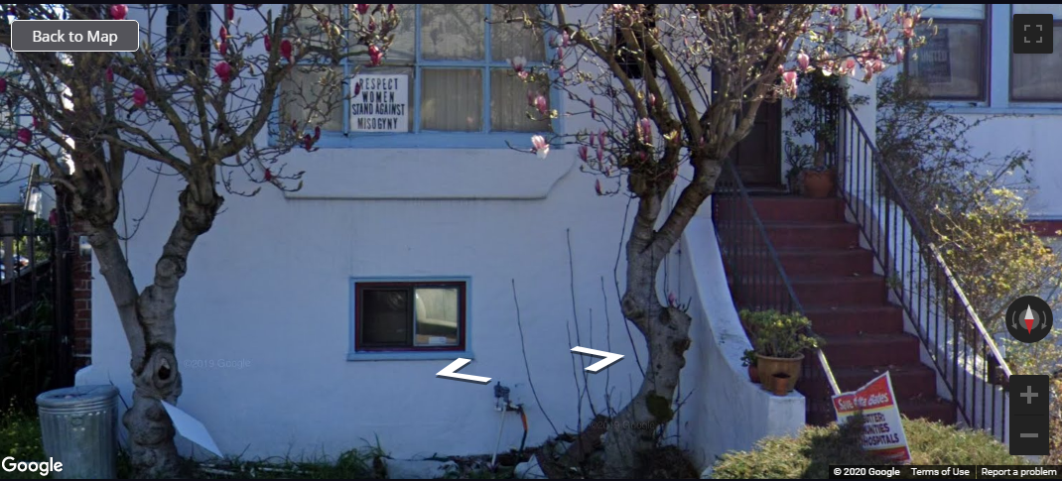
The less fortunate are taxed
Homeowners like 93 year old Mrs. Barringher just South of Ashby Bart are saddled with tax on reduced height understory.
She is the neighbor of the City of Berkeley Department Head who doesn’t pay tax on the attic and understory in the previous photos.
This costs her an extra $1100 per year.

Slide 11
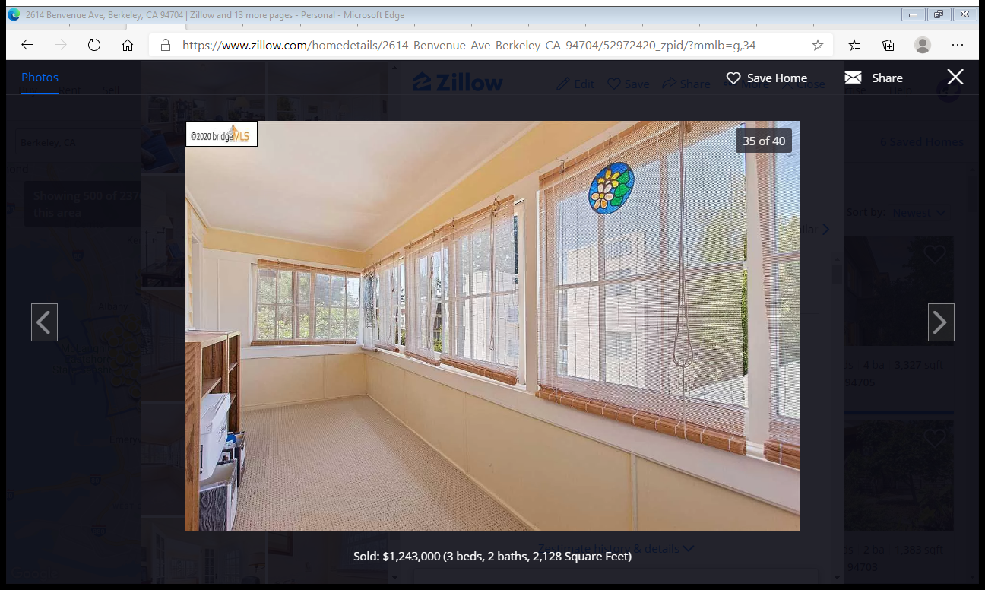
Should this sunroom be taxed?
It is taxed

Slide 12
Should this sunroom be taxed?
It is taxed at a ¼ rate for the square footage

Slide 13
Should this sunroom be taxed?
No mention in the Berkeley Tax Code that Sunrooms are tax exempt
It is UNTAXED

Slide 14
Tax varies, but not according to dwelling size
City taxes: $1513 | $1513 | $1996 | $1913
Dwelling size: 2527 ft2 | 1317 ft2 | 1804 ft2 | 1370 ft2
City taxes: $1513
Dwelling size: 2527 ft2
City taxes: $1513
Dwelling size: 1317 ft2
City taxes: $1996
Dwelling size: 1804 ft2
City taxes: $1913
Dwelling size: 1370 ft2

Slide 15
This homeowner pays only $540 in city taxes for 3 houses
The main house avoided taxation
From 12-20-2004 SF Chronicle: “…shrugged it off and built a house on one end of the property
and consolidated and modernized two early 20th-century cabins at the other end.”

Slide 16
Or simply tax record errors
This 24 unit 26,700 ft building is read by the Finance Department as 2670 ft, giving the landlord a nice discount of $24,000.

Slide 17
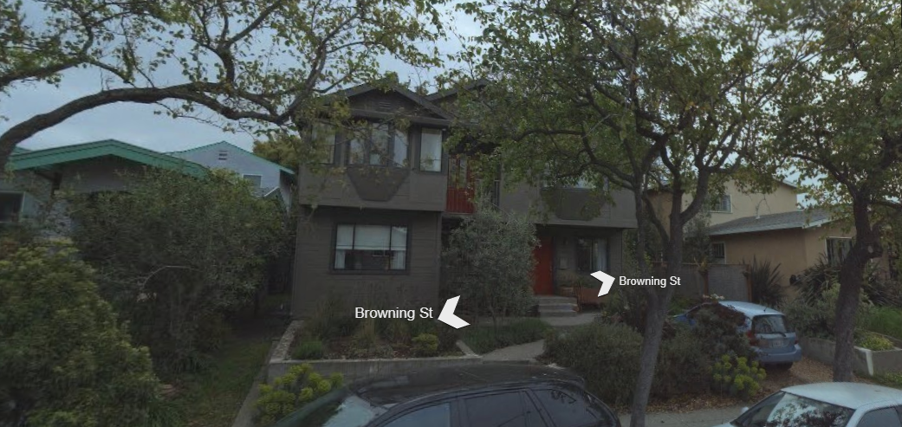
Many landlords benefit from Uncaptured Building Square Footage
This multi-family rental is 3367 ft2, but the City only imposes tax on 720 ft2.
This shortchanges the city $2700 a year and makes the landlord artificially wealthier!

Slide 18
This 5850 ft2 Home was built, but only the County recorded the correct square footage
The city did not
This city charges the lucky homeowner tax on 1264 ft2.
Homeowner saves over $4600 a year, and city services suffer

Slide 19
BATE’s quantified losses through permit record documentation

Slide 20
The Public Exposed Errors
Red Undercharged
1980s
Starting in the mid-80s, homeowners have found mistakes on their square footage taxes.
2002
Concerned citizens escaped tax complaints led to 57 parcel tax corrections
2020
Concerned citizens demand corrections for low income homeowners.
Green Overcharged, unless permit unrecorded

Slide 21
11 Harmed Homeowners Ask for Corrections
In July 2020, A group of 11 mostly elderly and/or minority families collectively wrote a letter to the City’s Finance Department, who incorrectly imposes taxes on their non-dwelling spaces. Bate has documented dozens of homes with unfinished spaces that are not taxed.
The financial harm to these families is substantial.
Their requests for correction have been rejected.

Slide 22
.
Ben Bartlet’s Verification Proposal will account for developed but untaxed square footage.
Hundreds of Homes have developed spaces and are already taxed by the City.
The Reconciliation proposal will effectively update the county on those permitted additions.
Hundreds of homes are already taxed for a renovated basement. This will not change under the proposal.
There will be no tax refund apocalypse

Slide 23
Berkeley City Auditors have recommended Reconciliation to Capture Square Footage
Ben Bartlett’s proposal will finally correct this ongoing source of revenue loss and harm to the more fragile constituents.
1994 Landscape and Park Audit
“The overall result is taxpayers are not always levied the correct fee because incorrect improvement square footage is used. Most errors found during the survey...resulted in parcels being levied for less than actual square footage.”
2005 City Audit
“There is likelihood that the taxable BSFT for some parcels might have been understated or overstated, resulting in improper assessments."
July 2012 Information Calendar after 2010 audit
“City Manager, with input from Planning should consider aligning the definition with Planning's. The City's practice of using square footage for more equitable distribution of the special tax would not change.”

Slide 24
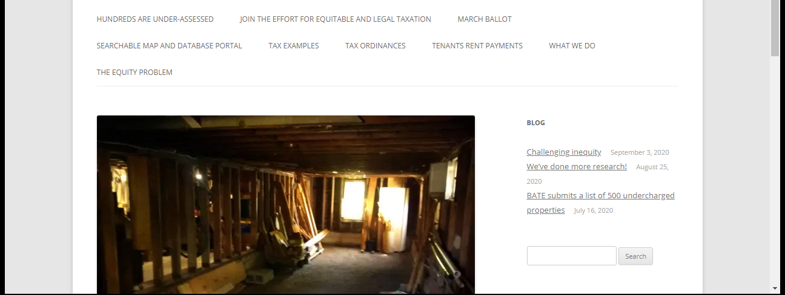
The 11 Harmed Homeowners corrections must be granted right away. They have been made financially fragile by the problem and if they want to sell, the unfair tax burden must be disclosed, to their detriment.

Slide 25
Another Benefit of the Bartlett Plan: End Exploitation of Black Homeowners
“We are being taxed for attic space that we have no access to.”
“We went to the City and there has been no response from them about correcting this.”
“I’d like to stay in this neighborhood”
“Each year our taxes go up so much and I worry that a year will come when I can’t afford it.”

Slide 26
Tax Reconciliation/Verification Recommendations
Allow corrections and refunds for the 11 Harmed Homeowners before Dec. 10
Make taxable square footage publicly available to the taxpayer by Dec. 1 on the City’s Parcel Viewer Portal.
Corrections applications for non-dwelling space will be accepted and processed starting before Dec. 31
Make taxable square footage available to home purchasers and realtors before Dec. 1
Correct the listed 824 underassessed properties before Dec. 31.
Perform a citywide taxable square footage reconciliation/verification with Planning and the County Assessor within 1 year.

